Slide 1
Harr Classifier
By: Sangha Yoon
Place: Creative Content Labs, Sangmyung University

Slide 2
Learn how the harr cascade object detection works.
The algorithm of Harr Cascade is created by Paul Viola and Michael Jones in 2001. They built Harr Cascade because they wanted a program, which is capable of detecting objects in images and videos. Their appearances do not depend on specific locations.
Harr Cascade is a machine learning based on positive (images of faces) and negative (images without faces) images.
According to this graph from the third slide, there are two colors. The white means positive images. The black means negative images.
1. Positive data points are examples of regions containing a face
2. Negative data points are examples of regions that do not contain a face.

Slide 3
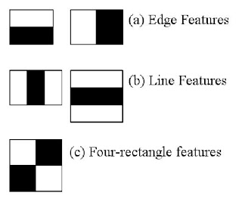
Types of haar features

Slide 4
Usage of haar features
For each feature, it finds the best threshold which will classify the faces to positive and negative. However, there will be an error.
Pixel Number = 0 = white
Pixel Number = 1 = black
Edge Features = Stage 1
Line Features = Stage 2
Four-rectangle Features = Stage 3
Through each image, Haar Cascade uses edge features, line features, and four-rectangle features in order to find its targets.

Slide 5
Examining Features

Slide 6
Examining Features

Slide 7
Output from haar cascade
If haar cascade finds its target from an image, then it marks with circles, ellipse, rectangles, , squares, or other shapes.
To find wanted shapes easily, the haar cascade files are required.

Slide 8
Haarcascade Files
haarcascade_frontalcatface.xml = looking for the cat’s face
haarcascade_frontalface_alt.xml = looking for the front face
haarcascade_lefteye_2splits.xml = looking for the left eye
haarcascade_righteye_2splits.xml = looking for the right eye
haarcascade_smile.xml = looking for the mouth
haarcascade_upperbody.xml = looking for the upper body
haarcascade_fullbody.xml = looking for the full body

